Slide 1
Serial Communication Interfaces
Ramesh S

Slide 2
External Communication
Communication with external devices is fundamental to controllers
Sensors, Actuators, Memory Devices (RAM, Flash),
Variety of devices to be connected including digital and analog devices
Cost and quality constraints have forced standard interfaces
Standard communication i/f define
HW characteristics: communication medium (twisted pairs, fiber, etc.) and signaling protocols
Communication protocol at the data link layer and higher layers
Multiple standards have emerged
UART/SPI/I2C, RS232, CAN, Ethernet, Blue tooth, WiFi, etc.
Many of these developed in the early days of computers for connecting `peripherals’
Modern Controllers have provision for some of the major interfaces
Many sensors come integrated with communication interfaces
ST Microelectronics LSM303D is a 3-axis acc.meter and magnetometer integrated with a I2C module

Slide 3
Communication Interface Standards
Several of them
UARTs, SPI, I2C, USB, CAN
Each of these are independent HW blocks in a typical controller with logic and storage
These blocks send and receive control and data signals in parallel and communicate with the CPU
Access and control to these modules via SFRs
Each block has a unique set of SFRs which can be read or written to program and get/put data
They are also used for configuring the blocks
E.g., communication speed, parity presence

Slide 4
Communication Parameters
1-1, 1-x
Serial or Parallel
Simplex, Duplex, half-duplex
Synchronous or Asynchronous
Symmetrical or asymmetrical (Master – Slave)
Flow control
Error detection – parity signal
Communication Speed
1200 bps – Several Kbps and Mbps

Slide 5
UART
Universal Asynchronous Receive Transmit protocol
Asynchronous means no common clock
Peer to peer protocol (no master-lave relationship)
Duplex Communication – Simultaneous two-way communication
The frame has a START bit, 8 data bits, STOP bit and optionally parity bit
The line is high in idle state and stop bit
The hosts look for line going low
The host pre-decide on the baud rate (bits per second) of transmission
9600bps (common), 1200 (low), 460Kbps (high) – multiples of 8
Tx
Rx
Rx
Tx

Slide 6
UART Block Structure (Example)

Slide 7
UART Transmission

Slide 8
Tx/Rx Operation
INT-CLK is derived from the CLK input of the block
CLK = 8 * INT-CLK
Tx Operation flowchart given here
Rx operation is similar

Slide 9
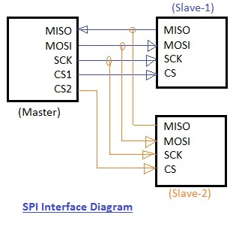
Serial Peripheral Interface (SPI)
High Speed protocol, 10 – 20 Mbps usually
RAM, Flash. SD cards, ADC/DACs accelerometers use this protocol
Synchronous protocol
Master – Slave Protocol
Every extra slave requires additional circuitary
Single Master who creates the clock signal for the slave devices
Master has 3 logical outputs and 1 input to/from each slave
Clock input, Slave Select Signal
Master to Slave Data – MOSI
Slave to Master Data - MISO
Duplex Communication
Master selects the slave
Serial communication
frame structure mfg. specific

Slide 10
SPI Communication Protocol

Slide 11
SPI Master Block Data Flow

Slide 12
Tx/Rx Operation
INT-CLK is derived from the CLK input of the block
INT-CLK = 2*CLK
Transmission and Reception takes place in different phases of CLK
Tx Operation flowchart given here
Rx operation is similar

Slide 13
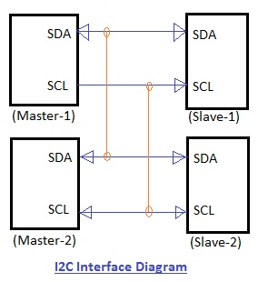
Inter-integrated Circuit - I2C
Communication among multiple devices with fixed lines
RAM, ADCs, OLED screens, accelerometers
Multi-master, Multi-slave Protocols
But less number of wires
Master decides the clock and selects the slave
The slaves have address which are sent in the data line
Supports 100 – 400 kbps, 3.5 Mbps
Half Duplex,
Start, Stop Bits and Ack bit for each 8 bits of data
Master selection is done by arbitration based upon the data sent in the SDA line
Winner is one whose data is on the bus
Master clocks are synchronized
More masters and slaves complicates the design

Slide 14
I2C Devices on a network

Slide 15
I2C Communication Signal Flow

